Slide 1

Project Title - Seasonal Agriculture Performance Analysis
NAME: SUSHIL KUMAR S
COLLEGE NAME: S.R.M UNIVERSITY - K.T.R Campus
AICTE STU ID : STU687a7e1023c951752858128

Slide 2

PROBLEM STATEMENT
Agricultural activities are influenced by seasonal variations in environmental conditions, farming practices, resource availability and market conditions. As a result, agricultural performance may differ from one season to another. However, raw agricultural data does not clearly explain how agricultural performance changes across seasons or what patterns can be observed in different seasonal conditions. The problem is to analyze the given agricultural dataset and investigate seasonal differences in agricultural performance by identifying meaningful patterns, trends, relationships and variations within the available data

Slide 3
Project Description
Seasonal Agriculture Performance Analysis is a data analytics project focused on understanding how agricultural performance varies across different seasons, geographical regions, and farming conditions. The project involves analyzing data related to crop production, environmental conditions, farming practices, resource utilization, and economic performance.The project includes data cleaning and preprocessing, exploratory data analysis, statistical analysis, and data visualization to identify important seasonal patterns, trends, relationships, and variations. The analysis compares agricultural performance across different seasons and examines how environmental and resource-related factors may influence agricultural outcomes.The key findings from the analysis are used to generate evidence-based insights and recommendations that can support better understanding of seasonal agricultural patterns and contribute to more informed agricultural planning and decision-making.

Slide 4

WHO ARE THE END USERS?
Farmers – to understand seasonal crop performance and resource usage.
Agricultural Departments & Government Agencies – for agricultural planning and policy decisions.
Agricultural Planners & Consultants – to identify seasonal trends and improve farming strategies.
Agribusinesses & Agricultural Organizations – to analyze production and economic performance.
Agricultural Researchers – to study relationships between environmental conditions and agricultural outcomes.

Slide 5

Technology Used
Python – Programming and data analysis
Pandas – Data cleaning, manipulation, and analysis
NumPy – Numerical computations
Matplotlib – Data visualization
Seaborn – Statistical data visualization

Slide 6
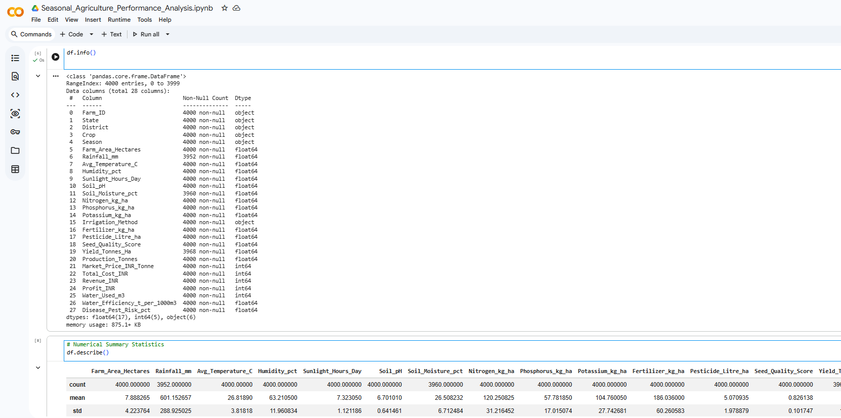
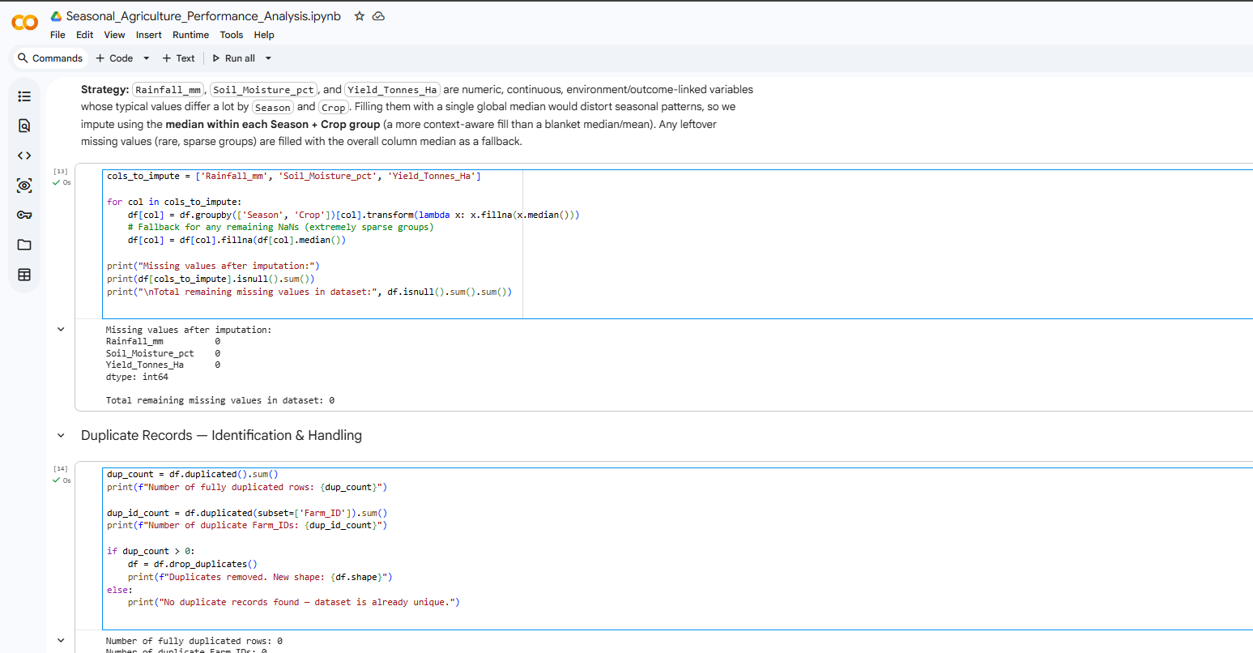
RESULTS
Code snippets of Data Exploration and handling

Slide 7
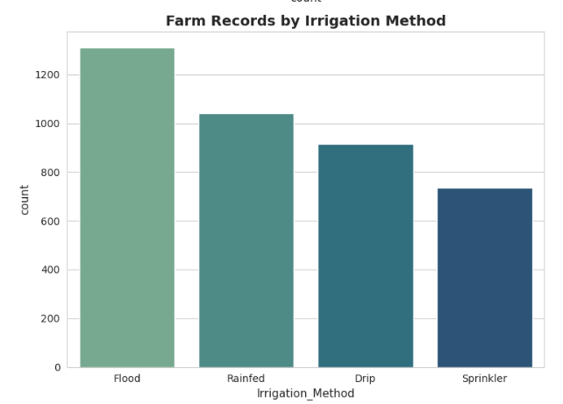
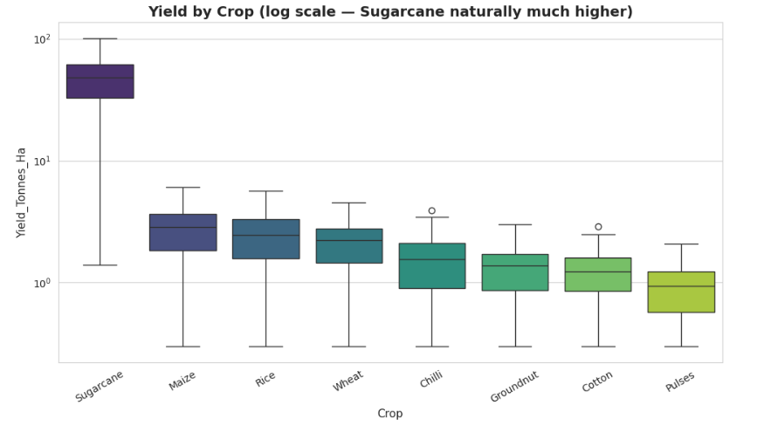
RESULTS
Bar chart – Farm records by irrigation method
Box plot – Yield by crop

Slide 8
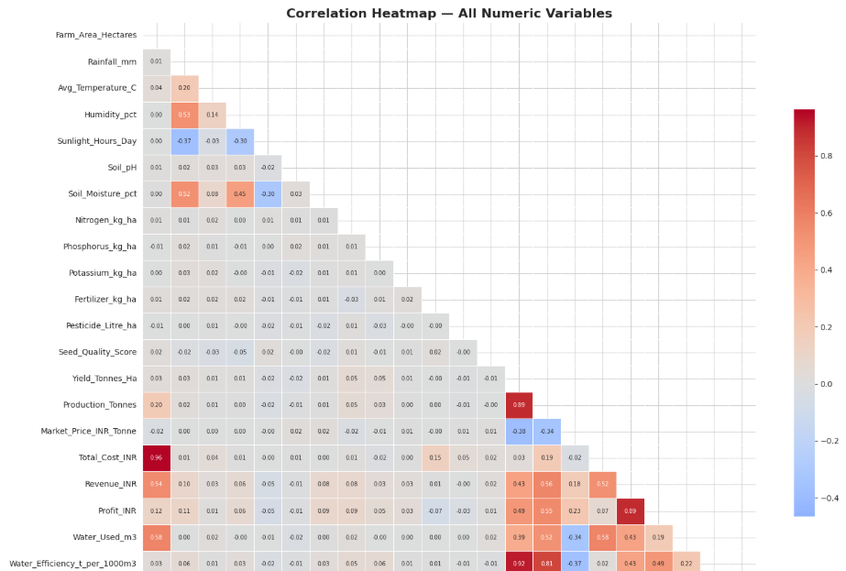
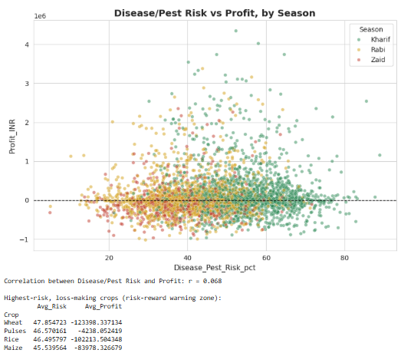
RESULTS
Correlation Heatmap
Scatter Plot – Pest risk vs profit by season

Slide 9
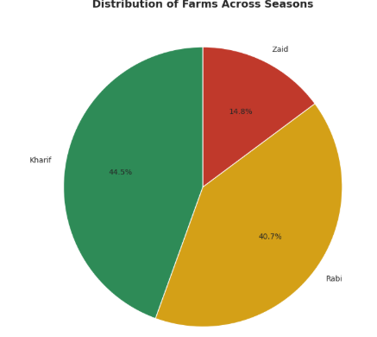
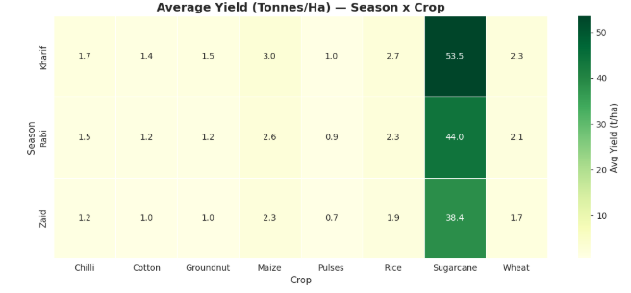
RESULTS
Pie chart – Distribution of farms across seasons
Heatmap – Average Yield Season into crop

Slide 10
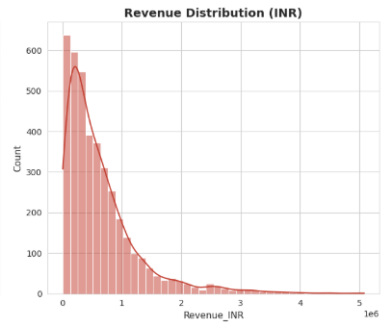
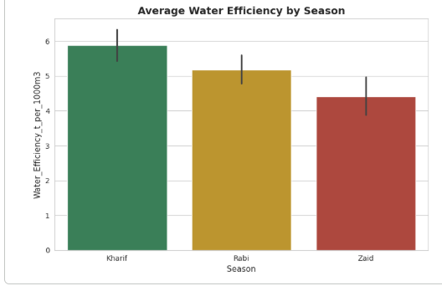
RESULTS
Histogram – Revenue distribution
Bar chart – Average water efficiency by season

Slide 11
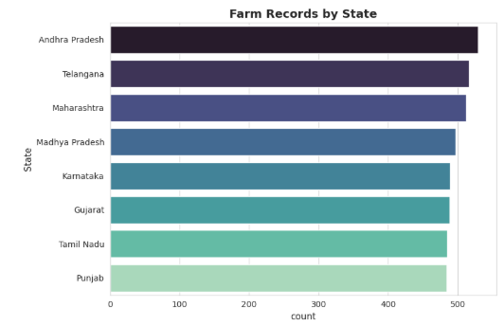
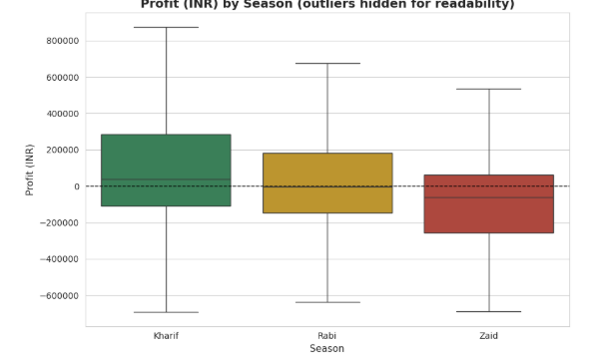
RESULTS
Horizontal Bar chart – Farm records by State
Box plot – Profit by season

Slide 12
Future scope
Crop production prediction
Real-time weather data integration
Interactive agricultural dashboard
Machine learning-based analysis
Analysis of more crops and regions
Resource optimization
Market price prediction
Seasonal farming recommendations
Early identification of unusual patterns

Slide 13
GitHub Link
https://github.com/Sushiii3103/Seasonal-Agriculture-Performance-Analysis.git

Slide 14
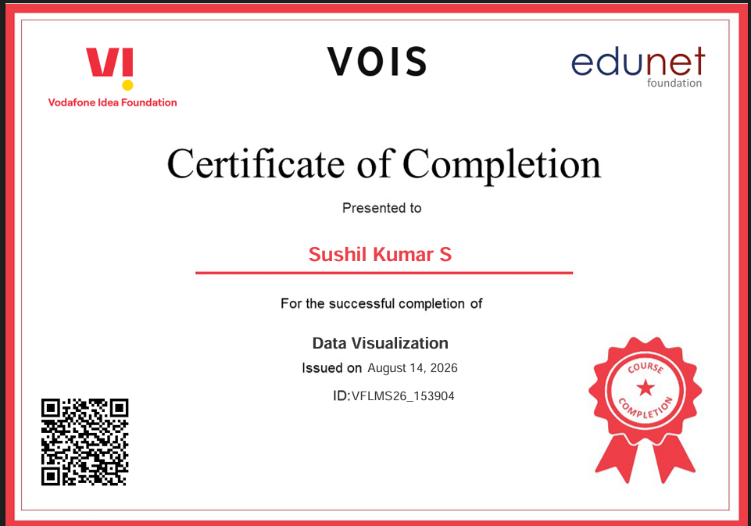
VOIS Course completion certificate - Course name- Data Visualization

Slide 15
Thank you
.
.

